Slide 1
MKTG 571:
Customer Profitability
Customer Lifetime Value (CLV), Customer Equity (CE), and Shareholder Value

Slide 2
Today’s Agenda
To discuss how to calculate customer lifetime value (CLV)
To show how it is calculated using actual data
To discuss the Tuscan Lifestyles case results

Slide 3
Selection Metrics
Is CLV better?
Using 54 months of data to predict the next 18 months (for the top 15% of customers)
 | CLV | RFM | PCV
Avg Revenue | 30,427 | 21,201 | 21,929
Gross Value | 9,184 | 6,360 | 6,579
Variable Costs | 107 | 100 | 95
Net Value | 9,077 | 6,260 | 6,484

Slide 4
Customer Lifetime Value
Definition:
The sum of calculated cash flows –
discounted using the weighted average
cost of capital (WACC) – of a customer over
his or her entire lifetime with the company.

Slide 5
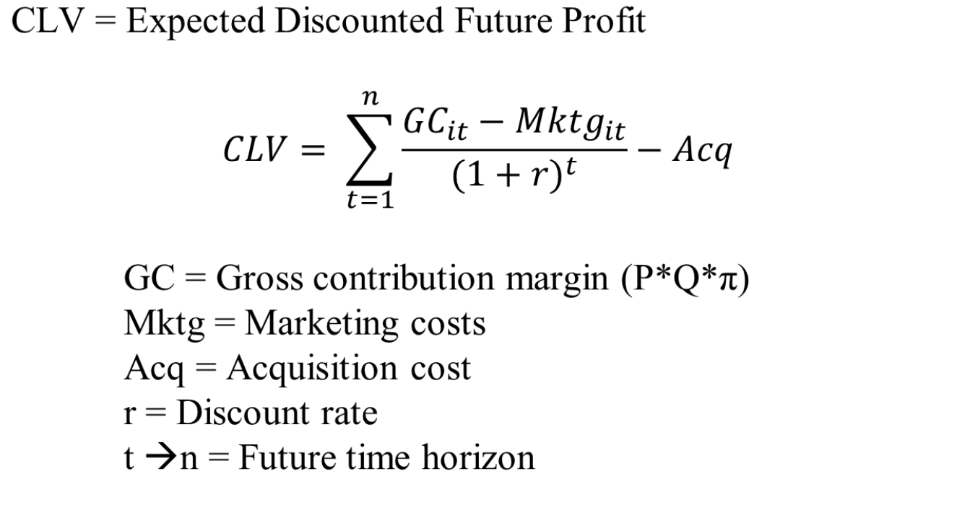
Customer Lifetime Value

Slide 6
Customer Lifetime Value
Computational and Substantive Issues:
  How many periods to compute? (t →n)
  How to predict gross contribution margin in the future? (GC_{it})
  How to determine future marketing spending? (Mktg_{it})
  Is there anything missing from the CLV model?

Slide 7
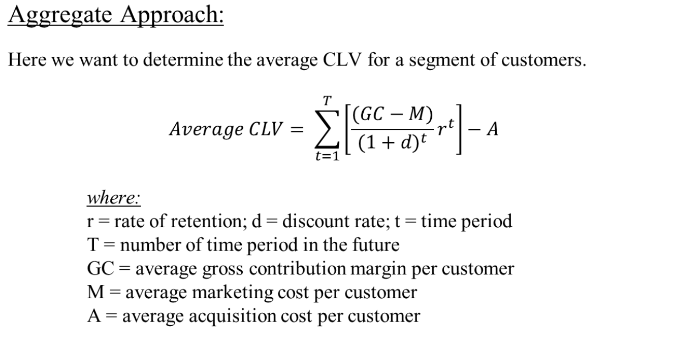
Customer Lifetime Value

Slide 8
Customer Lifetime Value
Aggregate Approach:
Suppose we have a cohort of 100 customers for a bank. We observe 3 months of purchases starting in January 2011. We have the following data:
  Projected average gross contribution = $500 per year
  Average marketing cost = $45/year
  Average acquisition cost = $60
  Discount rate = 15% per year
  Retention rate = 75% per year

Slide 9
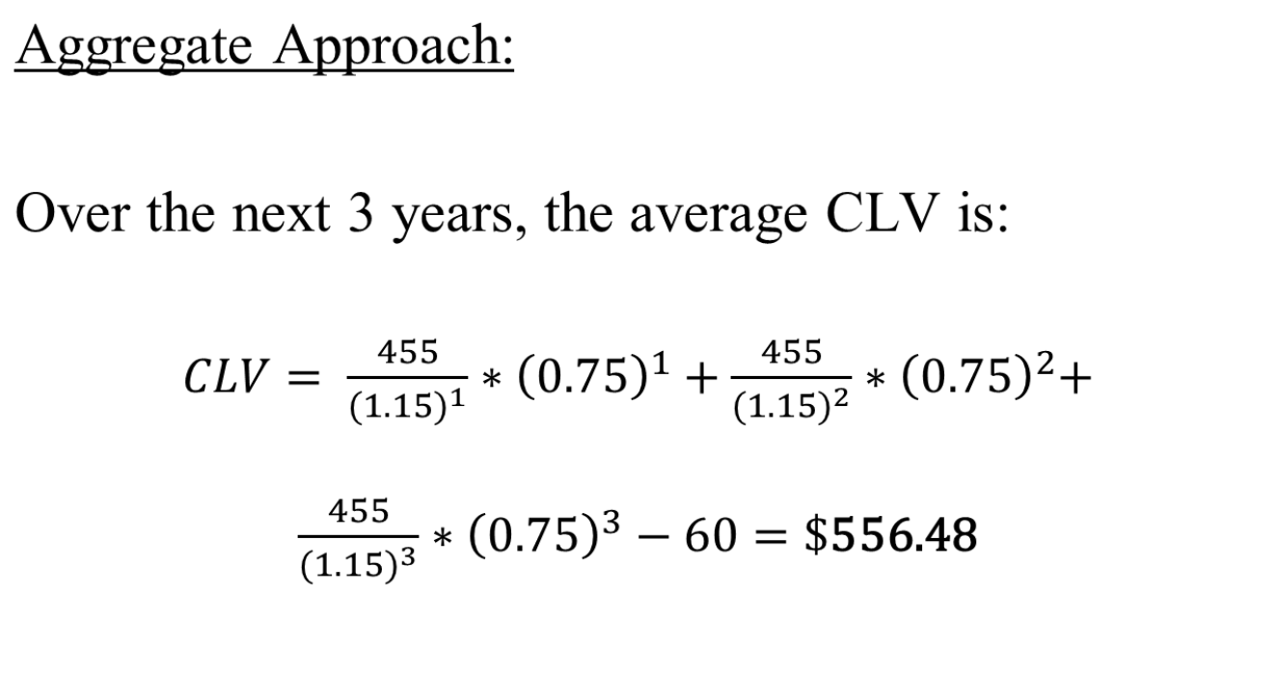
Customer Lifetime Value

Slide 10
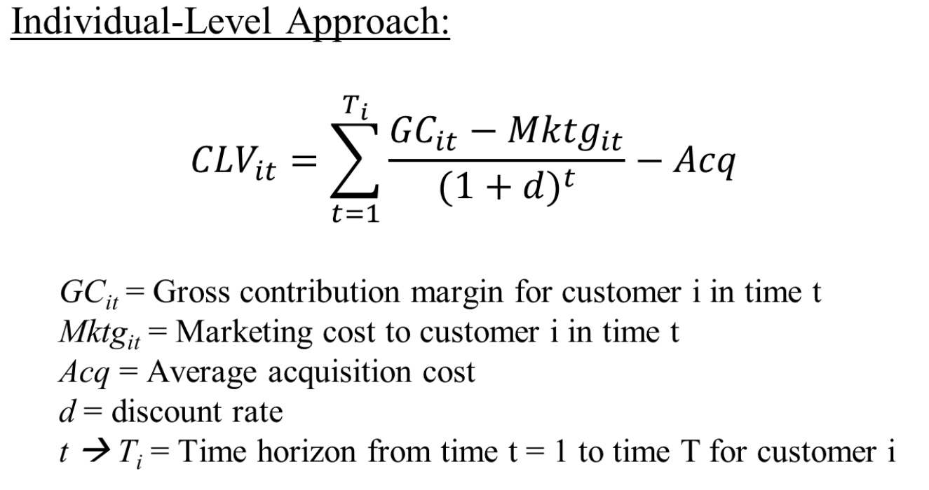
Customer Lifetime Value

Slide 11
Customer Lifetime Value
Individual-Level Approach:
  What’s different here than in the aggregate approach?
    Dealing with retention of an individual
    Predictions for individuals rather than averages

Slide 12
Customer Lifetime Value
Dependent Variables of Interest:
  GC_{it} [usually P(Buy_{it})*E(GC_{it}|Buy_{it}=1)]
  Mktg_{it} [Should we predict it?]
  T_{i} or P(Alive_{it}) [Depends on contractual nature]
What are the drivers of each of the three models?

Slide 13
Customer Lifetime Value
Typical CLV Drivers:
  Exchange Characteristics
  Customer Characteristics
  Product Characteristics
  Firm’s Marketing Actions

Slide 14
Customer Lifetime Value
Model Formulation/Data Requirements:
  For prediction you need time dynamics
  (i.e. DV is in time = t and IVs are in time = t – x)
  For example: GC_{it} = f (GC_{i,t-1}, …)
  You need sufficient history to make better future predictions
  You need to select the right model for the DV type
  (e.g. is the variable continuous, discrete, etc.)

Slide 15
Customer Equity
Conceptually, what is it?
  All the discounted profit from current customers
  All the discounted profit from customers acquired in the future

Slide 16
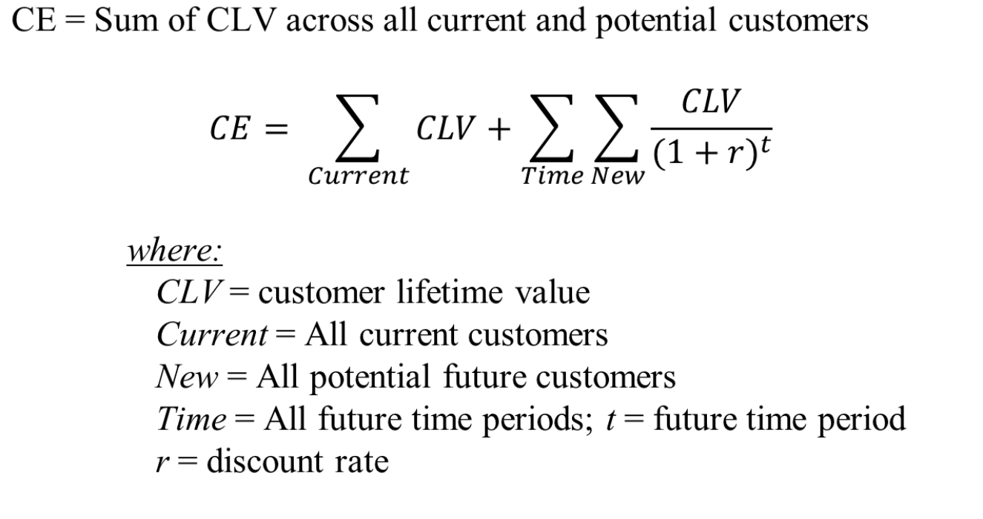
Customer Equity

Slide 17
Customer Equity
We know some different techniques for computing the CLV of current customers.
What about future customers?
Computational Issues:
  How many new customers should we expect?
  Does risk matter?

Slide 18
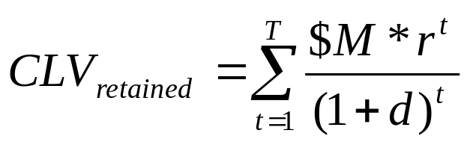
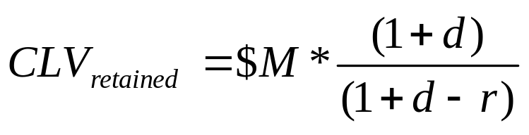
Computing CLV
What is the average value of a retained customer?
M = (GC - Mktg)
d = (discount rate)
r = (retention rate)
Turns out we can convert the infinite sum into:

Slide 19

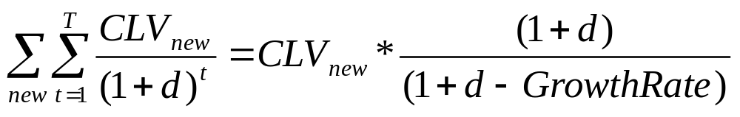
Computing New CLV
What is the average value of a new customer?
M = (GC - Mktg)
d = (discount rate)
GR = (growth rate)
What about all new customers?

Slide 20
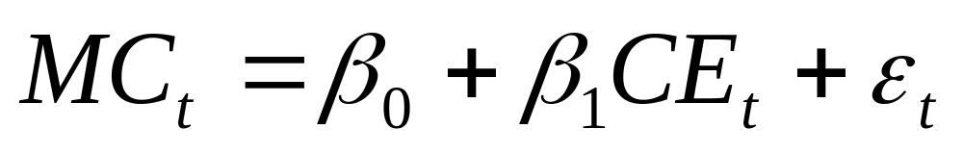
Is CE related to MC?
What can we do?
Run a regression!
What do you expect (hope) to find?

Slide 21
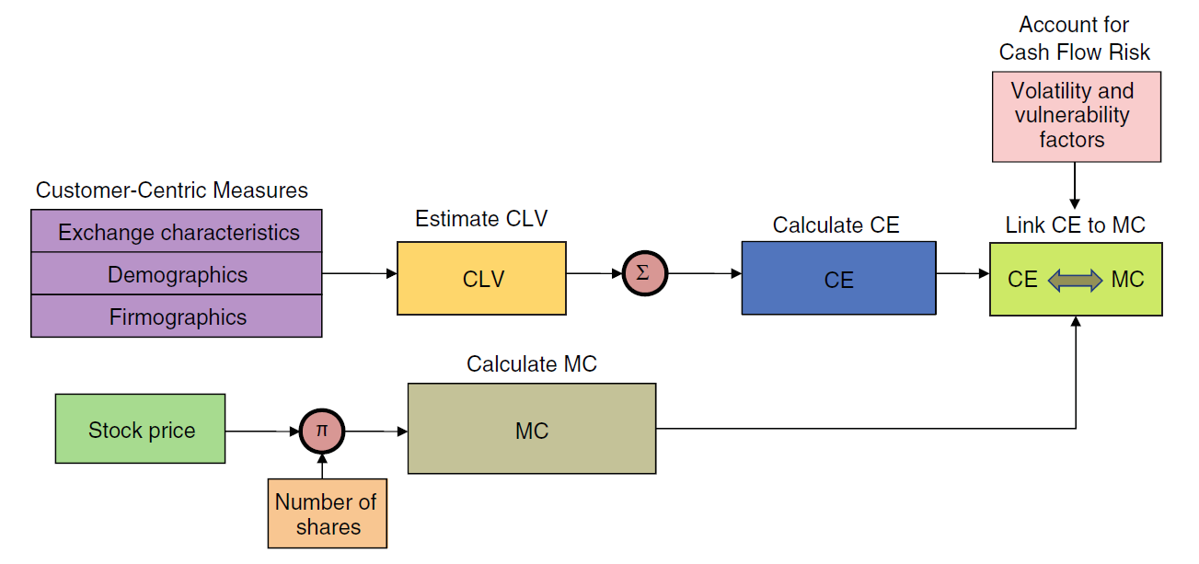
CE to Shareholder Value
Is there a link between customer equity and shareholder value?
** From Kumar and Shah (2009) **

Slide 22
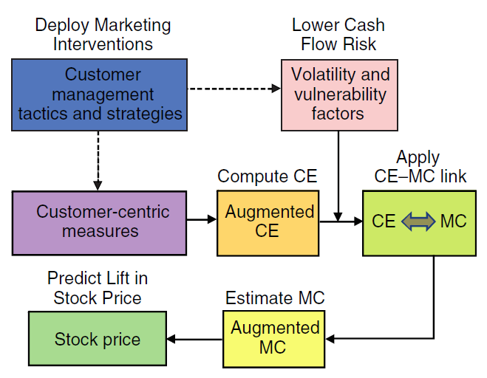
CE to Shareholder Value
How can we leverage CRM strategies to increase stock price?
** From Kumar and Shah (2009) **

Slide 23
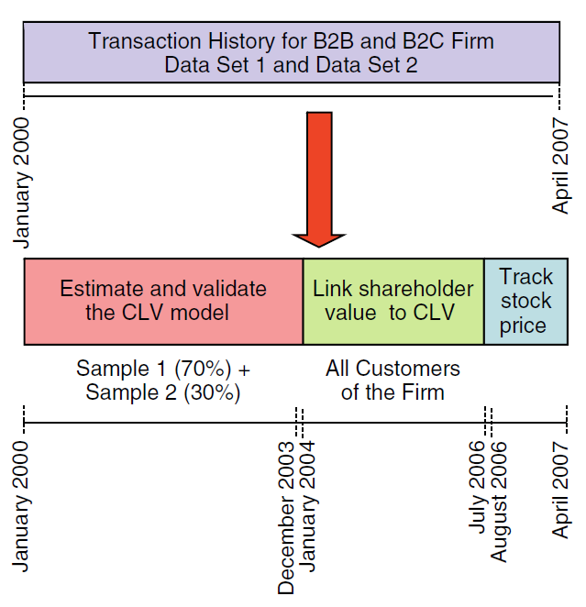
CE to Shareholder Value
What is the timeline for the analysis?
** From Kumar and Shah (2009) **

Slide 24
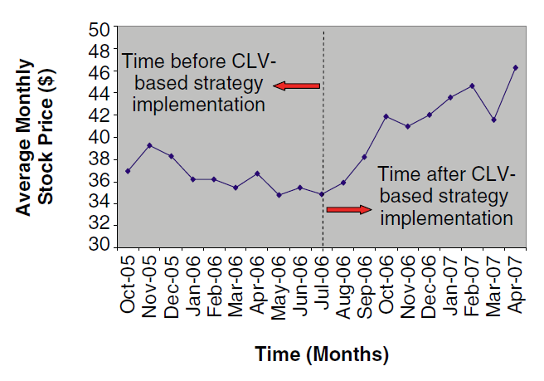
CE to Shareholder Value
What happened pre- and post-strategy implementation?
** From Kumar and Shah (2009) **

Slide 25
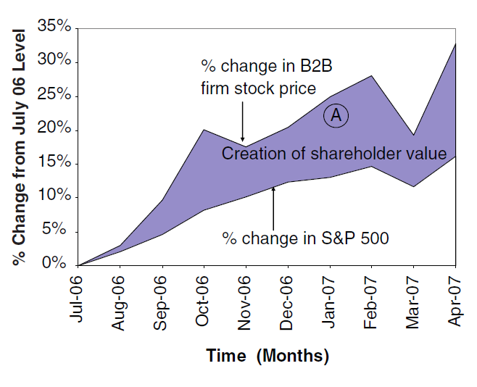
CE to Shareholder Value
How did this firm compare to the general market performance during the same time period?
** From Kumar and Shah (2009) **

Slide 26
Tuscan Lifestyles
Questions:
  What is the average CLV (after 5 years) of a customer whose initial purchase is less than $50?
  What is the average CLV (after 5 years) of a customer whose initial purchase is $50 or greater?

Slide 27
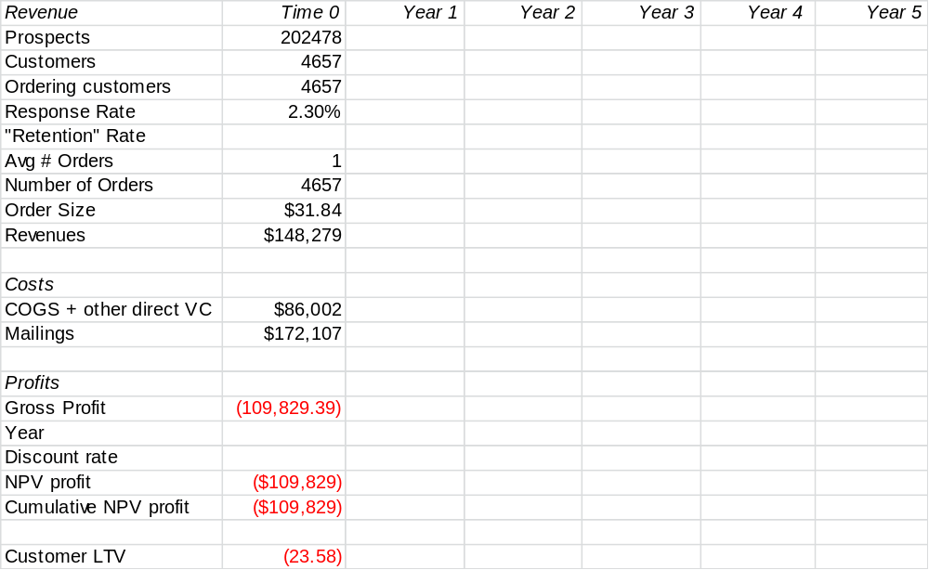
Initial Order < $50

Slide 28
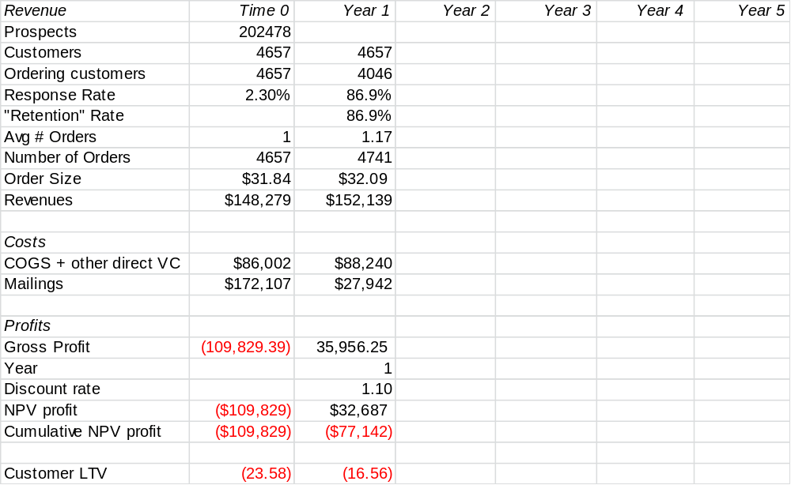
Initial Order < $50

Slide 29
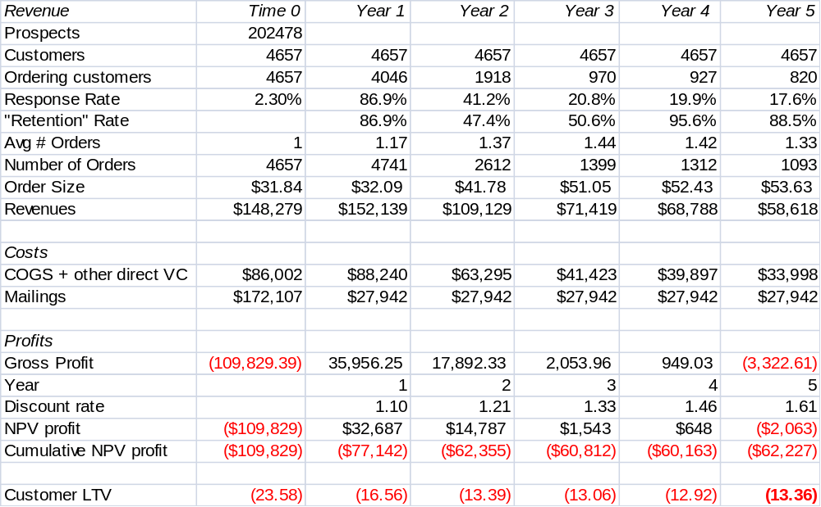
Initial Order < $50

Slide 30
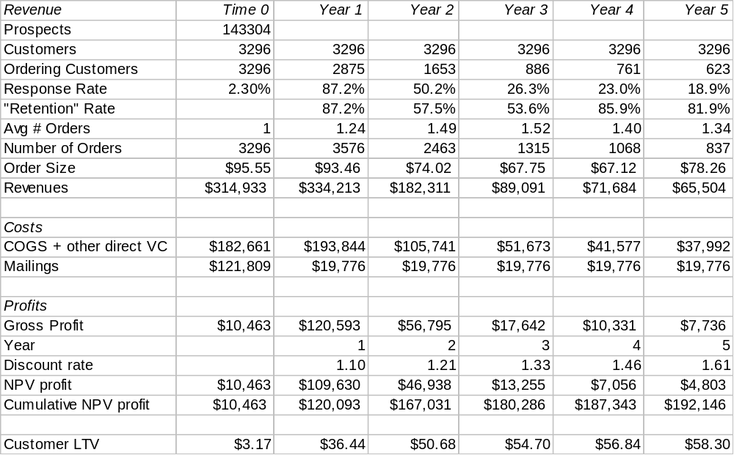
Initial Order >= $50

Slide 31
Tuscan Lifestyles
Other Questions:
  Based on these CLVs, what marketing plans might be advisable?
  Do you agree with Joan’s assumption that 5 years is a reasonable time horizon?
  Do you have suggestions for other ways to group customers for determining lifetime values?
  What additional information might be helpful for Joan?

Slide 32
For Next Class
Topic:
  Data Mining, Decision Trees, and Data Analysis
Reading:
  Applied Logistic Regression
  Assessing a Model’s Performance: Lifts, Gains, and Profits
Assignment:
  None

